Slide 1
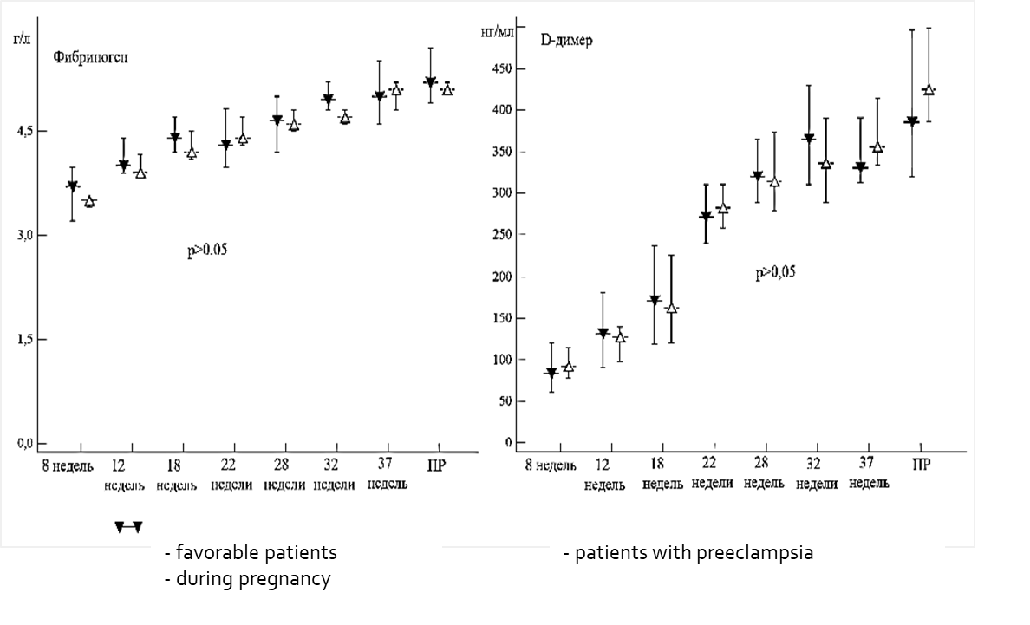
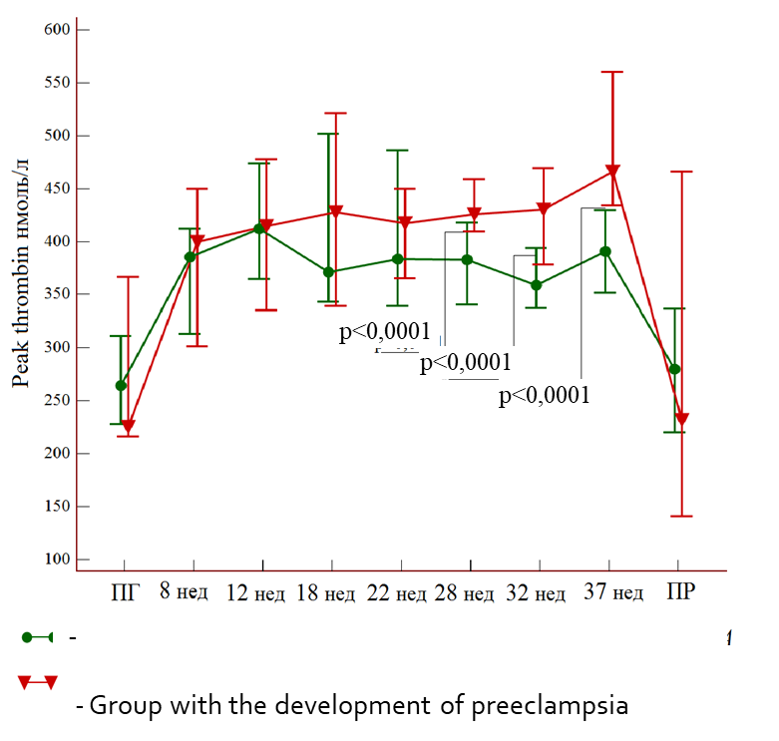
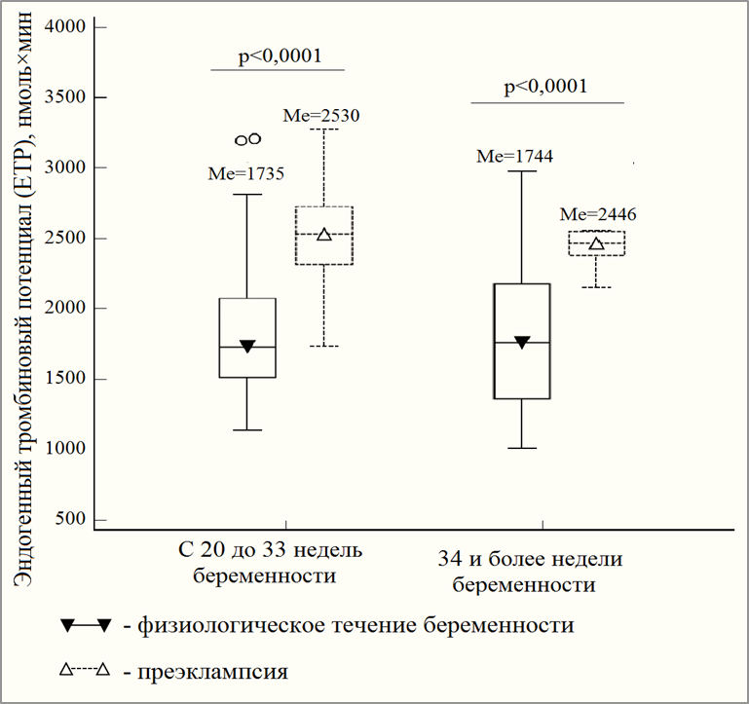
Connection of activation of the hemostatic system with the development of various phenotypes of preeclampsia Autor: Terekhina Vasilisa Yurevna, assistant of department of obstetrics and gynecology Altai state medical university
Introduction and aime
Preeclampsia (PE) occurs in 1–8% of pregnant women and determines not only maternal and perinatal morbidity, but it is also the second cause of maternal mortality. To date, there is not a single test with sufficient sensitivity and that provides early diagnosis and identification of the risk of preeclampsia, despite the identified high-risk groups. Given the new data on pathogenesis, the paradigm of ideas about preeclampsia is changing. Early PE, caused by pathology of the placenta and late, associated with extragenital pathology of the mother. In this connection, the emphasis in predicting PE is aimed at identifying biological markers that are actively involved in the ontogenesis of the placenta.
Results
1)The control group included 200 women with a favorable course of pregnancy, the main group - 209 patients whose pregnancy was complicated by the development of early and / or late (severe) preeclampsia.
At the first stage, a single-center retrospective cohort study was conducted aimed at identifying significant predictors of early and late preeclampsia based on a study of the history of pregnancy and childbirth.
In the second, a single-center prospective cohort study aimed at studying the parameters of the hemostatic system with the development of early and late preeclampsia at the critical time of implantation and placentation.
2) At the stage of a prospective study, the parameters of the hemostatic system were studied at the critical time of implantation and placentation and correlated with the development of early and late preeclampsia.
The study of traditional markers of thrombinemia showed that in both groups the level of fibrinogen and D-dimers increased by the time of delivery by 1.8 and 4.7 times, respectively.
Materials and methods
The control group included 200 women with a favorable course of pregnancy, the main group - 209 patients whose pregnancy was complicated by the development of early and / or late (severe) preeclampsia.
At the first stage, a single-center retrospective cohort study was conducted aimed at identifying significant predictors of early and late preeclampsia based on a study of the history of pregnancy and childbirth.
In the second, a single-center prospective cohort study aimed at studying the parameters of the hemostatic system with the development of early and late preeclampsia at the critical time of implantation and placentation.
3)When studying the level of tissue factor (TF) - the main initiator of thrombin formation and its inhibitor (TFIP), more informative data were obtained. Regardless of the phenotype of PE, the TF level increases by 8 times, and the ratio of tissue factor to its inhibitor increased by 13 times. A change in these indicators was noted 2-3 days before the development of the clinical picture of PE, requiring a decision on delivery
4)According to the integral thrombography test, it was found that the development of preeclampsia is accompanied by an increase in thrombin formation from 18 weeks of gestation by 10% relative to the indicator in the group with a favorable course of pregnancy. in terms of Peak thrombin, the ETP median in the group with a favorable pregnancy and with the development of early and late preeclampsia 2-3 days before the development of the clinical picture of PE also showed significant differences. The increase in thrombin formation was determined both in the group of patients with early and in the group of patients with late PE, and there were no significant differences.
Summary
The laboratory parameters analyzed in the present part of the work are objective predictors of preeclampsia, which allows us to consider the activation of blood coagulation as a reasonable prerequisite for heparin prophylaxis.
.
Contact Information: Terekhina Vasilisa Yurevna, assistant of department of obstetrics and gynecology Altai state medical university. Barnaul 8-913-247-0008. Vasutka_07@mail.ru

